Slide 1

Predictor
Owen Rafferty

Slide 2
Project Idea
I wanted to create a UFC fight predictor based on this kaggle dataset. The idea is we will build a deep learning model with tensorflow that can see if the red fighter will win or lose a match.

Slide 3
The Data
This dataset holds all fights from the beginning of the ufc in 1993 to june of 2019. For the cleaning of this data it was a very well put together dataframe so I only had to do a few things. First was to drop all fights before the rules for the ufc were put into place. Then I dropped all draws and all rows that contained any nan values since there was no accurate way to replace that data.

Slide 4
EDA Visualizations
For my eda I had a lot of columns to look through and understand over 140+. Although I noticed that most of these columns just talked about the fighter average opponent and what they fought like so I did not include them in the heatmaps below as those were not as relevant as the actual fight data between the 2 fighters. While looking at these 2 heat maps you can see a clear difference between the 2 they do not look anything alike which really showed me why mma is a real diverse sport. So many different styles mean that good features for one fighter are another fighters burden. An example shown with the 2 heat maps for instance are the leg kicks it seems that most fighters do not bother with leg kicks or are not as strong as a tool in their arsenal of attacks but that is not the case for Donald Cerrone the fighter I choose to look at since he is a very seasoned fighter with plenty of data. The leg kicks for Donald Cerrone are a crucial part of his game with a positive correlation of .28, while for the all fighter heat map we see that it is the complete opposite with a negative correlation of .26. This is one of the reasons why I choose to encode the fighters names as each fighter really does bring his own style to the UFC because mma is such a diverse sport. It has dozens of different styles such as grappling based jiu jitsu or striking based boxing and the best fighters are usually a mix of them all.

Slide 5
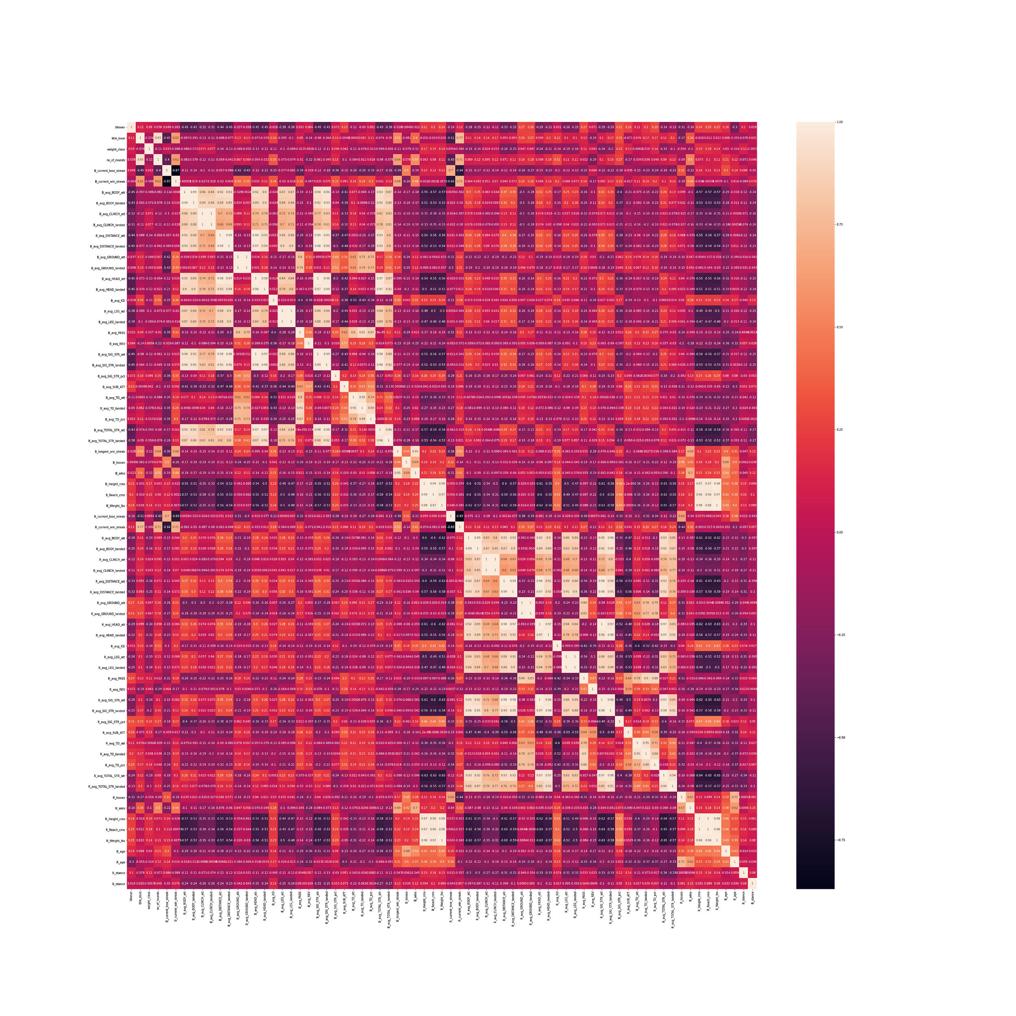
EDA All Fighter Heatmap

Slide 6
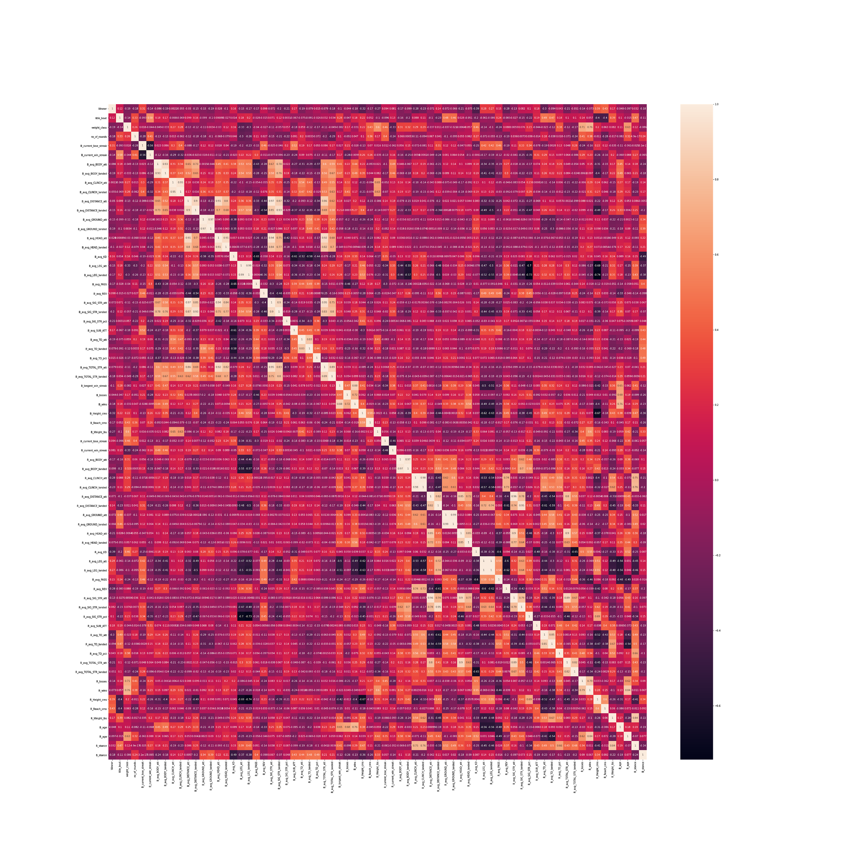
EDA Cowboy Heatmap

Slide 7
Columns
'R_fighter', 'B_fighter', 'Referee', 'date', 'location', 'Winner', 'title_bout', 'weight_class', 'no_of_rounds', 'R_current_lose_streak', 'R_current_win_streak', 'R_draw', 'R_avg_BODY_att', 'R_avg_BODY_landed', 'R_avg_CLINCH_att', 'R_avg_CLINCH_landed', 'R_avg_DISTANCE_att', 'R_avg_DISTANCE_landed', 'R_avg_GROUND_att', 'R_avg_GROUND_landed', 'R_avg_HEAD_att', 'R_avg_HEAD_landed', 'R_avg_KD', 'R_avg_LEG_att', 'R_avg_LEG_landed', 'R_avg_PASS', 'R_avg_REV', 'R_avg_SIG_STR_att', 'R_avg_SIG_STR_landed', 'R_avg_SIG_STR_pct', 'R_avg_SUB_ATT', 'R_avg_TD_att', 'R_avg_TD_landed', 'R_avg_TD_pct', 'R_avg_TOTAL_STR_att', 'R_avg_TOTAL_STR_landed', 'R_longest_win_streak', 'R_losses', 'R_avg_opp_BODY_att', 'R_avg_opp_BODY_landed', 'R_avg_opp_CLINCH_att', 'R_avg_opp_CLINCH_landed', 'R_avg_opp_DISTANCE_att', 'R_avg_opp_DISTANCE_landed', 'R_avg_opp_GROUND_att', 'R_avg_opp_GROUND_landed', 'R_avg_opp_HEAD_att', 'R_avg_opp_HEAD_landed', 'R_avg_opp_KD', 'R_avg_opp_LEG_att', 'R_avg_opp_LEG_landed', 'R_avg_opp_PASS', 'R_avg_opp_REV', 'R_avg_opp_SIG_STR_att', 'R_avg_opp_SIG_STR_landed', 'R_avg_opp_SIG_STR_pct', 'R_avg_opp_SUB_ATT', 'R_avg_opp_TD_att', 'R_avg_opp_TD_landed', 'R_avg_opp_TD_pct', 'R_avg_opp_TOTAL_STR_att', 'R_avg_opp_TOTAL_STR_landed', 'R_total_rounds_fought', 'R_total_time_fought(seconds)', 'R_total_title_bouts', 'R_win_by_Decision_Majority', 'R_win_by_Decision_Split', 'R_win_by_Decision_Unanimous', 'R_win_by_KO/TKO', 'R_win_by_Submission', 'R_win_by_TKO_Doctor_Stoppage', 'R_wins', 'R_Stance', 'R_Height_cms', 'R_Reach_cms', 'R_Weight_lbs', 'R_age'
This data frame consisted of a lot of columns theses are about half as for every column that begins with R there is another one the begins with B describing the blue fighters stats.

Slide 8
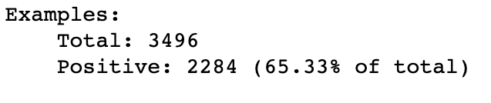
Feature tuning
Since as I said before I am using a tensorflow deep learning model I made sure all the data was converted into numbers and did some analysis to see that 65% of the data set was all red wins so it is skewed more towards the red fighter winning for sure. Seeing this I made sure to test the imbalanced dataset and a balanced one that was 50% red and 50% blue wins.

Slide 9
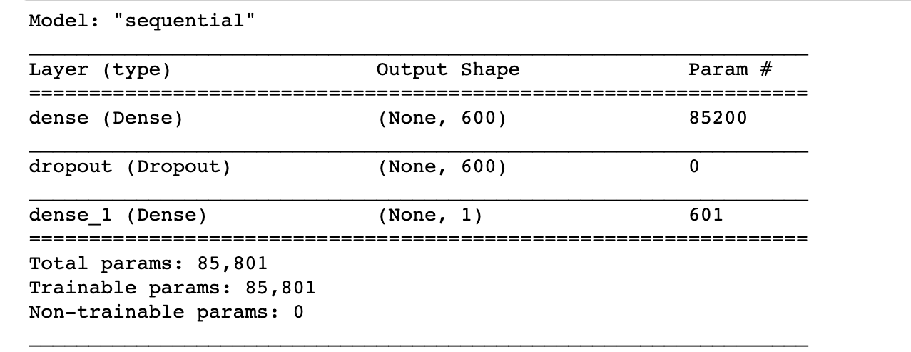
Models
I created 2 Deep learning models one with just initial weights and another with initial/class weights. Both models followed the same basic structure as follows.

Slide 10
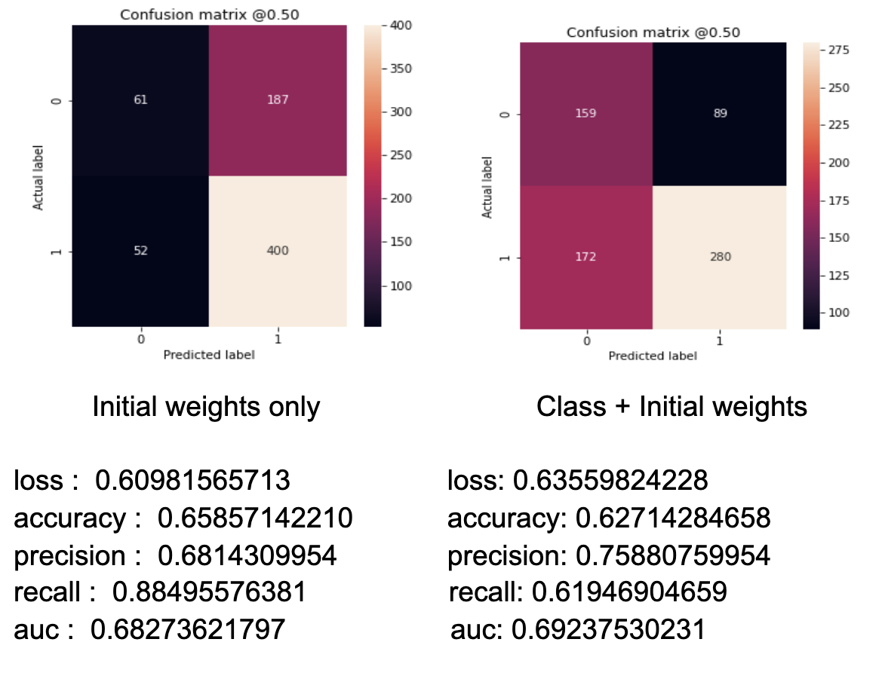
Models stats Red skewed data

Slide 11
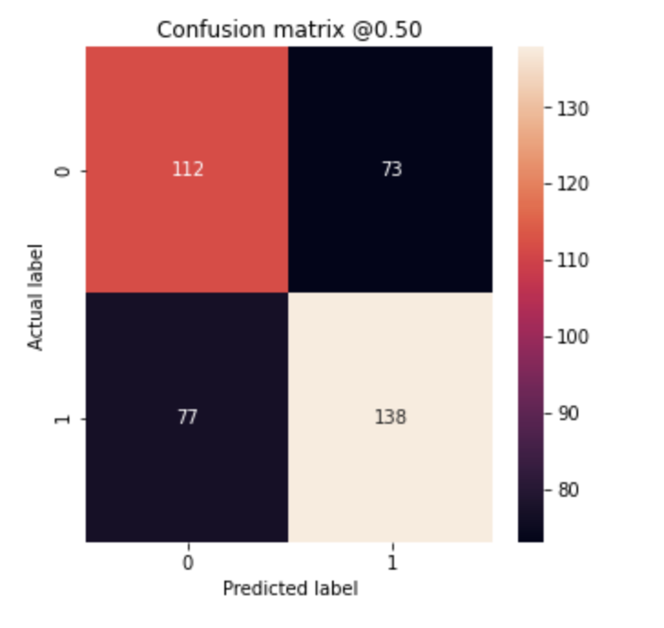
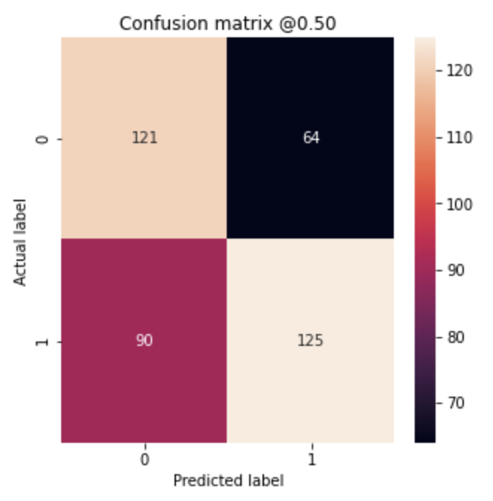
Models stats Balanced data
Initial Weights Only
loss : 0.71151006221
accuracy : 0.625
precision : 0.65402841567
recall : 0.6418604850
auc : 0.6682715415
Class + initial weights
loss : 0.90262174606
accuracy : 0.61500000953
precision : 0.66137564182
recall : 0.58139532804
auc : 0.65586429834

Slide 12
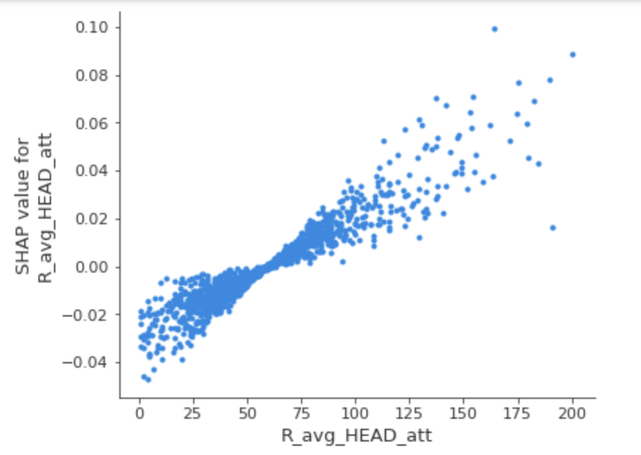
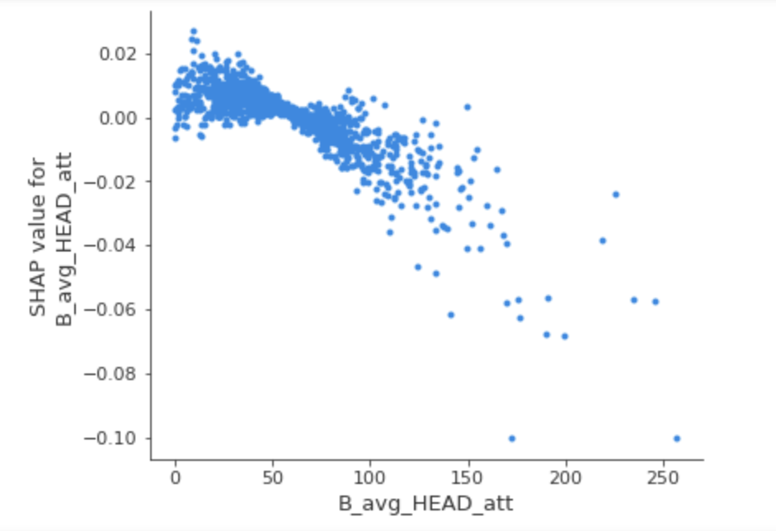
Feature analysis

Slide 13
Feature Analysis
Using shap for my feature analysis it showed me exactly what I was expecting or even better for some features. Most features that benefitted the blue fighter would negatively impact the model while the features correlated to the red fighter would usually positively impact the model. As you have seen with the head attack graphs as the red fighter has more head strikes that has a positive correlation on the model. We see this happen because the strikes your landing on your opponent's head as a fighter the more damage your are doing to them and taking a lot of hits to the head in a short span of time is not good for anybody especially in a fight. For the blue fighter we see the exact opposite the more strikes to the head they land on their opponent we see that it negatively affects the model. This is because we are predicting if the red fighter wins and the red fighter is for sure less likely to win the more head strikes they take.

Slide 14
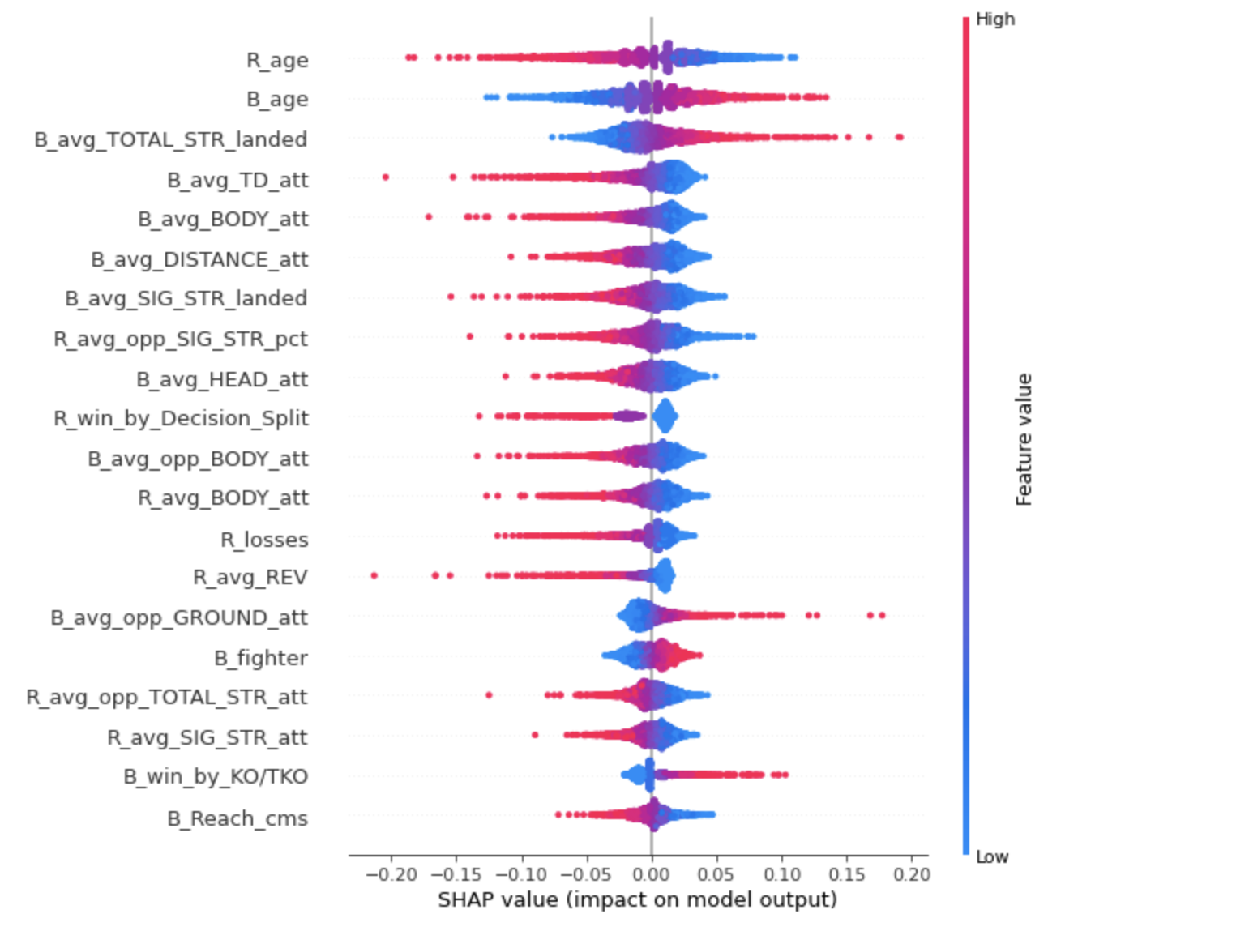
Feature Analysis

Slide 15
Conclusion
In conclusion I would say if you are a average UFC fan my model can definitely help you decide who is gonna win if you want to possibly make a bet as its way better than any random guessing.That said my model is fairly good at predicting when a red fighter wins but not so good at when a blue fighter wins so might want to take that into consideration. The winner column is based on the red fighter winning so it does make sense and the data does skew towards the red. I did try to train with a balanced dataset but the accuracy came out to be about the same as the red biased model just a few percent less. I would also like to play around with the making of the model more maybe adding a tanh activation layer just to see how it can affect my model for positive or worse. To sum it up I think this predictor came out ok I was hoping to get a little more out of my model and this project but with the time constraints/how hard it was making my first tensorflow model it came out ok all in all.

Slide 16
Future Improvements
As with any project the possibilities are always endless. For this predictor specifically I would love to play around with the tensorflow deep learning model more and try to get that accuracy above 70%. I would also like to try training on datasets of specific weight classes as the weight classes do tend to have their own trends in them and would love to see how it could help the model if it even will.
Special thanks to my mentor Rahul Sagrolikar for all the help really helped me learn everything I used in this project.

